Slide 1
Data Sanitizing Lab

Slide 2
Data Sanitizing Lab
This lab will explore how to sanitize data and show the data being sanitized
Materials needed
Kali Linux Machine
Software Tools used
recoverjpeg (Linux Command)
shred (Linux Command)
xxd (Hex Dump Program in Linux)

Slide 3
Objectives Covered
Security+ Objectives (SY0-501)
Objective 5.8 - Given a scenario, carry out data security and privacy practices
Data destruction and media sanitization

Slide 4
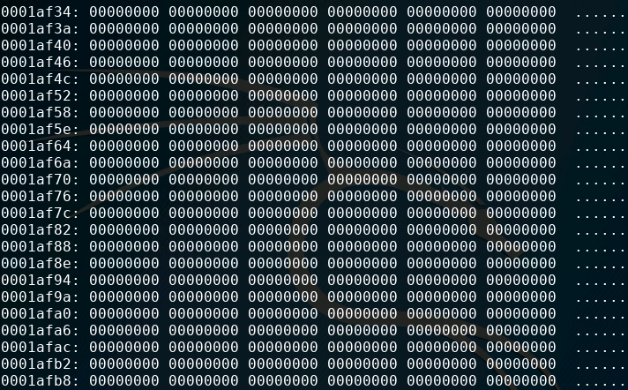
What is a Data Sanitizing?
Data Sanitizing is the process of removing and destroying data
Removing it permanently
Making it irreversible
Can be done in multiple ways
Overwrite old data
Degaussing
Magnetic field near an magnetic disk drive to destroy data stored (such as HDD or floppy)
Does not apply to newer solid state disk drives (SSDs)
Notes:
Bank: Chase
Username: jsmith17 Password: @pp13s33d

Slide 5
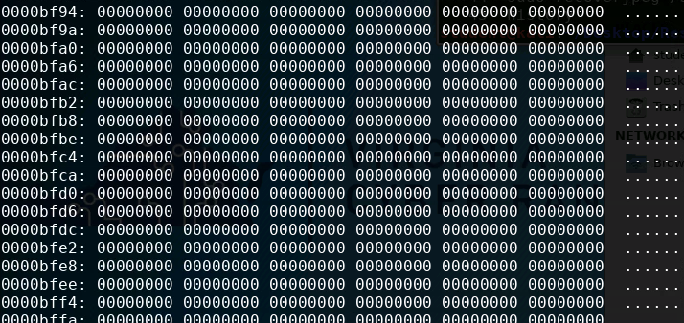
The Data Sanitizing Lab
Setup Environment
Download images
Delete an image
Recover JPEG images
Open JPEG as binary file
Write over the image
Write 0’s over the image
Use shred to Completely Erase Contents

Slide 6
Setup Environment
Log into your range
Open the Kali Linux Environment
You should be on your Kali Linux Desktop

Slide 7
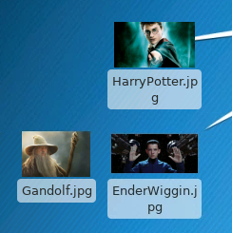
Download Images
Open a web browser
Navigate to images.google.com
Search for images on Google
Download 3 different images
Make sure to download jpeg images
Use “file:jpg” in search query for this
Move the images to your Desktop
Open the Downloads folder
Move the images to Desktop
3 images on a Desktop

Slide 8
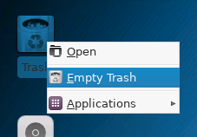
Delete an Image
Move an image to the Trash
Empty the Trash
Right-click on the Trash
Select the “Empty Trash” option
Verify the file is not in the trash
Open the trash
Can you find the image anywhere?
No? That means it’s gone forever, right?
Emptying the trash

Slide 9
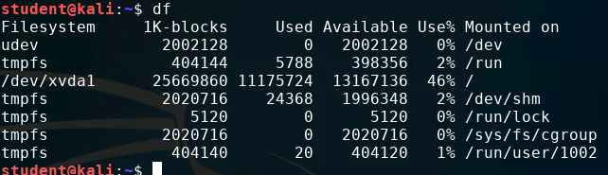
Find File System
Open the Terminal
Use the following to find the file system:
df
You should see the file system
Should be /dev/file_system
Write the file system down
Name of the file system

Slide 10

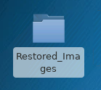
Recover JPEG Images
Create a folder on the Desktop
Navigate to the Desktop
cd Desktop
Make a new folder
mkdir Restored_Images
Navigate into the folder
cd Restored_Images

Slide 11
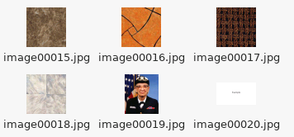
Recover JPEG Images
Make sure you are in the Restored_Images directory in the Terminal
Restore any deleted JPEG images from your system:
sudo recoverjpeg <Your File System>
What is happening?
System is scanning the entire drive for deleted images
This does take time
There will probably be hundreds of images recovered
Where are all of these images from?
When it’s done, were you able to find the image you deleted?
Look inside the Restored_Images folder on the Desktop
Restored Images

Slide 12
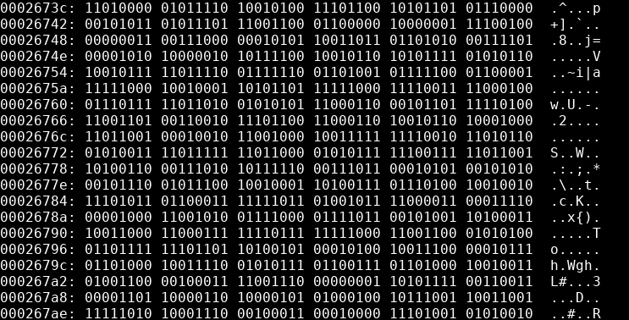
Open JPEG as Binary File
What does a JPEG image look like at the binary level?
Navigate to the Desktop
See the image stored in binary*:
xxd -b <ImageName.jpg>
xxd is a hex dump program
-b is showing the output in binary
*If xxd is not installed on your system, run the following command to install xxd:
sudo apt-get install xxd -y

Slide 13
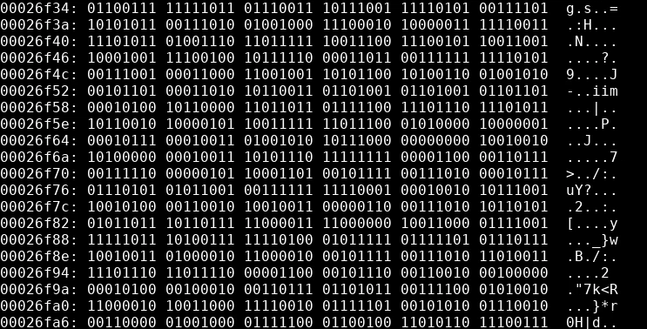
Write over the Image
Write a binary pattern over the image
shred <ImageName.jpg>
Shred overwrites files
Look at the binary of the files
xxd -b <ImageName.jpg>
Is there a pattern in the binary?
Are you able to open the image?

Slide 14
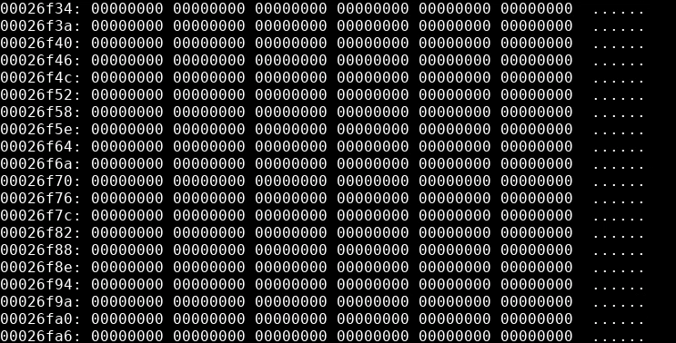
Write 0’s over the Image
Use the shred command to write 0’s over the image
shred <ImageName.jpg> -z
The -z says to write over with 0’s
Look at the binary of the files
xxd -b <ImageName.jpg>
What is different about the binary this time?
Why would you not be able to recover this file?

Slide 15
Use Shred to Completely Erase
Use the following shred command to completely erase and image:
shred <ImageName.jpg> -z -u
-z covers with 0’s
-u completely removes the file too
You should notice the file completely removed from your Desktop.

